Slide 1
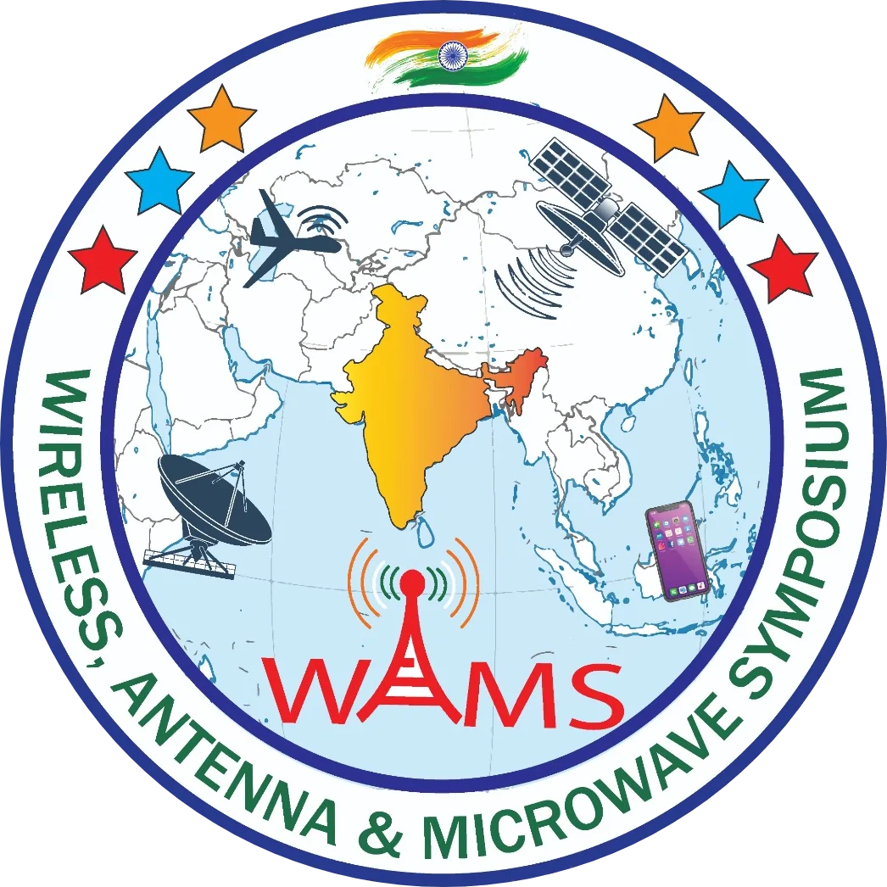

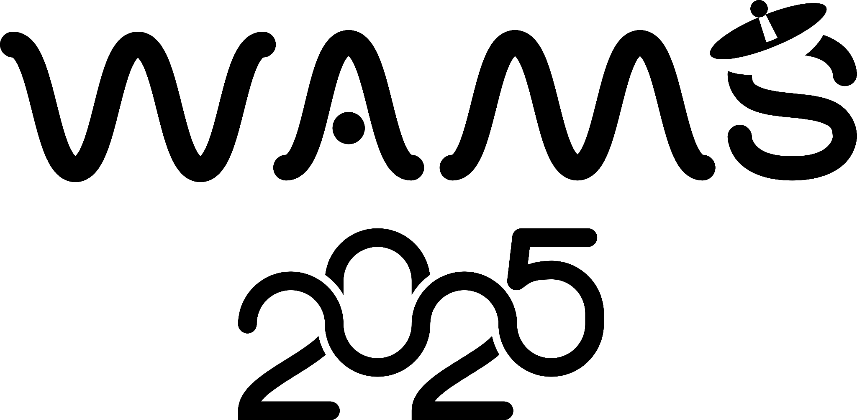
INVESTIGATION ON ORTHOGONALLY ALIGNED METAMATERIALSINSPIRED MIMO ANTENNA FOR WIDEBAND APPLICATIONS
4th IEEE Wireless Antenna and Microwave Symposium (WAMS 2025)
Sunil Kumar Sodisetty
UG student,
Department of Electronics and Communication Engineering
Dr.Venkateswara Rao Manikonda
Associate Professor,
Department of Electronics and Communication Engineering
Paper ID: 329

Slide 2

Abstaract
This work presents a dual-band MIMO antenna inspired by metamaterial techniques. The proposed antenna consists of two identical strip-shaped elements placed orthogonally to achieve polarization diversity. Simulation results show that the antenna operates efficiently in the wideband range from 4.05 GHz to 10.6 GHz.
The influence of metamaterials significantly improves performance, achieving a transmission coefficient below -15 dB.
Due to its wide bandwidth and compact design, the antenna is a strong candidate for future wireless technologies, including beyond 5G applications.

Slide 3
Motivation
Our main motivation is to design a compact and efficient MIMO antenna that can operate over a Wide Band frequencies making it useful for various wireless technologies like 5G, Wi-Fi, Bluetooth.
Solution: WB + MIMO → Higher Capacity, Reduced fading
Goal to design a MIMO antenna with metamaterial structure for WB applications.

Slide 4
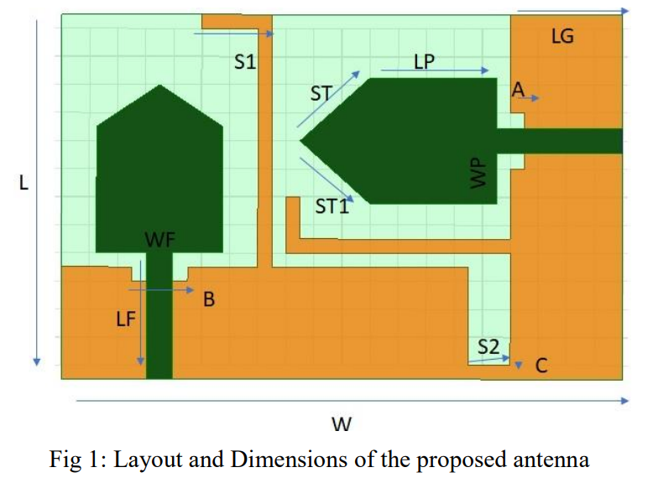
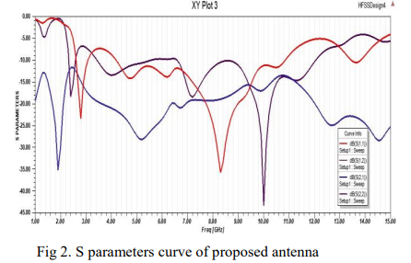
Related Work
Ultra-Wide Band MIMO Notched Antenna for WLAN and Mobile Applications
Antenna Design Highlights
Type: Dual-element MIMO antenna with notch for WiMAX rejection.
Size: 26 mm x 40 mm (FR-4 substrate, 1.6 mm thick).
Structure: Rectangular patch + triangle top + defected ground with stubs.
Frequency Range and Performance
Operates in 3.1 GHz to 10.6 GHz → Ultra-Wideband (UWB).
Notch band (WiMAX rejection) at 3.0 – 4.2 GHz.
Working Mechanism
Dual-antenna system on a single substrate with partial ground and defected ground structure (DGS) for reduced coupling.
Stub connections help maintain low isolation.
Polarization diversity: One port excitation doesn’t impact the other → independent MIMO performance.
Radiation patterns show dipole-like shape at 5 GHz and quasi-omnidirectional at higher frequencies.
S parameters

Slide 5
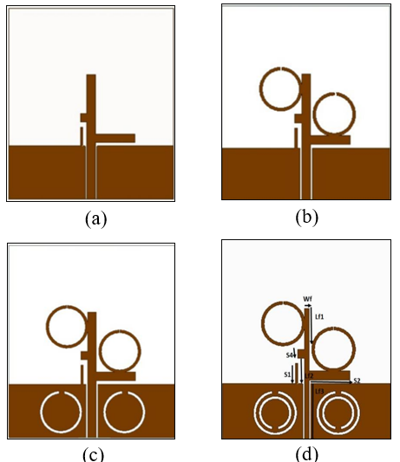
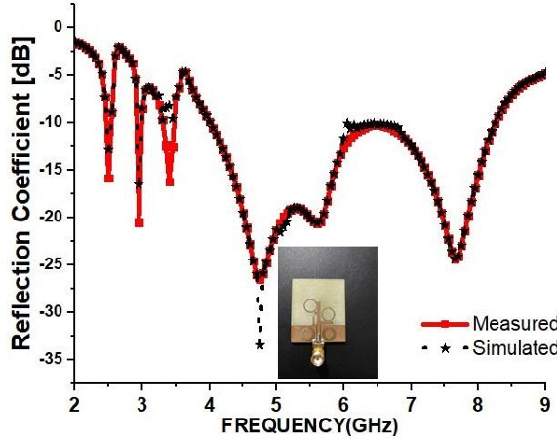
Related Work
Metamaterial Inspired Quad Band Circularly Polarized Antenna
Antenna Design Highlights
Type: CPW-fed quad-band antenna.
Substrate: FR-4 (εr = 4.4), size: 32 mm × 38 mm × 1.6 mm.
Feeding Technique: Coplanar Waveguide (CPW).
Frequency Bands Covered:
2.4 GHz (WLAN/ISM/Bluetooth)
3.35 GHz (WiMAX)
5.8 GHz (High-Speed Wireless)
7.25–8.5 GHz (Satellite communication: X-band & ITU band)
Working Mechanism
SRR/CSRR enhances bandwidth & circular polarization.
Each iteration of design improves gain, adds CP bands.
S parameters
Antenna Iterations

Slide 6

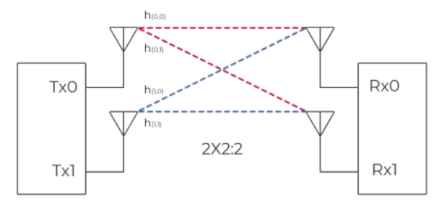
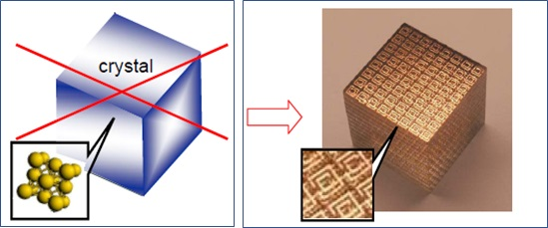
Introduction
While many studies aim to design a single antenna to cover all frequency bands, MIMO antennas can efficiently cover larger Wideband ranges.
Additionally, the unique properties of Metamaterials play a crucial role in shaping electromagnetic behavior, enhancing antenna performance
Wideband is widely used in applications like WIFI, Bluetooth, real-time location systems (RTLS), and automotive radar systems.
2×2 MIMO (2T2R) doubles data throughput by using two well-isolated, orthogonally polarized antennas to transmit simultaneous data streams over the same frequency band
2x2 MIMO
View of Metamatrials structure
WB Applications

Slide 7
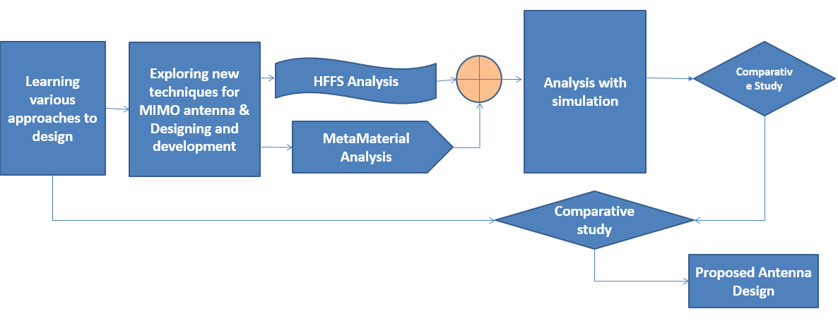
Methodology

Slide 8
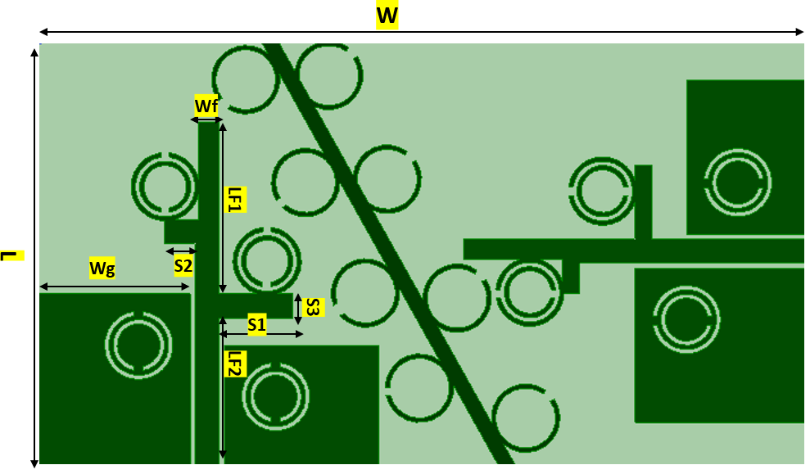
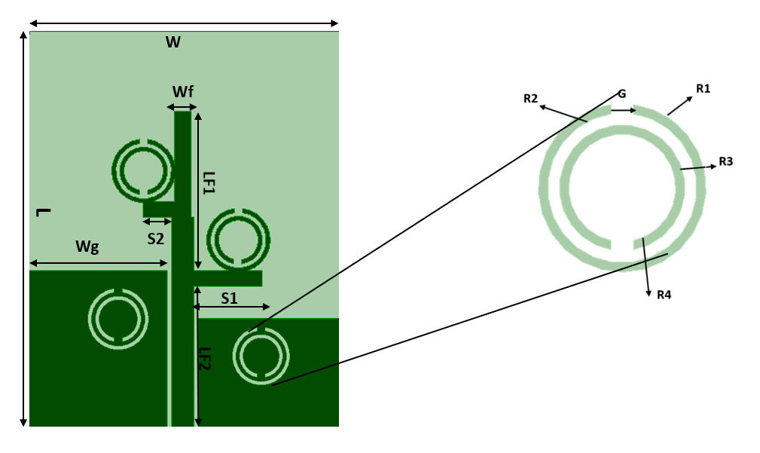
Design Approach and Dimensions
Parameter | Units in mm | Parameter | Units in mm
W_{g1} | 9 | L_{f1} | 20
L_{g1} | 10 | L_{f2} | 13.35
L_{g2} | 7 | L_{f3} | 9
G | 0.5 | R₁ | 2
W_{f} | 1 | R₂ | 1.75
W_{f1} | 4.5 | R₃ | 1.5
W_{f2} | 2 | R₄ | 1.25
L | 25 | S | 5
W | 45 | SL | 1
a | 13 | b | 27
Front View
Dimensions of MIMO MODEL in terms of mm
Monopole Antenna

Slide 9
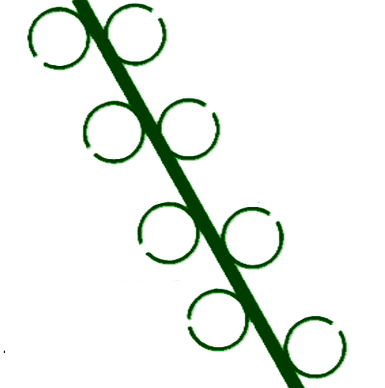

Design Approach and Dimensions
R1
A 45° stub incorporated with SRRs on either side
R2
Other Techniques to Improve Isolation
Defected Ground Structure
Neutralization Lines
Parasitic Elements
Orthogonal Placement of Antenna Elements
Electromagnetic Band Gap (EBG) Structures
SL
45degrees

Slide 10
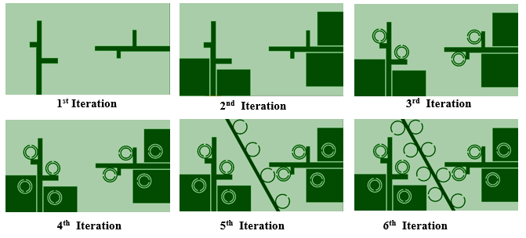
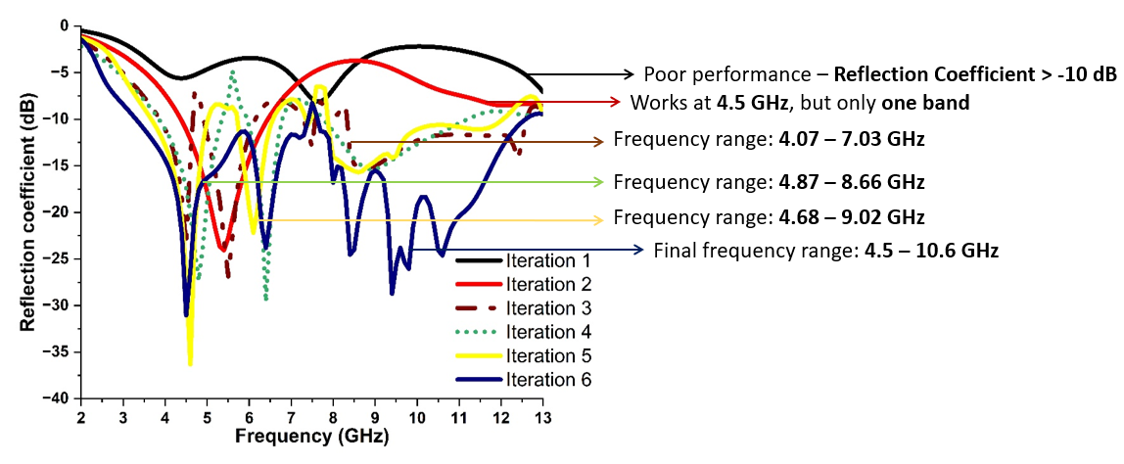
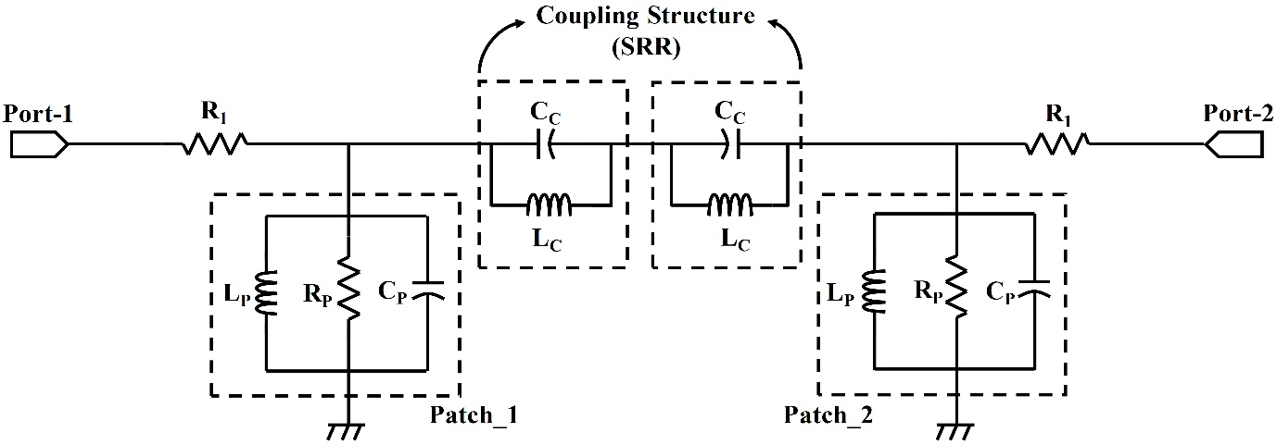
Results
Resonant Frequency (GHz) – 5.8 GHz,7.6 GHz, 10.20 GHz, 11.50 GHz
“circular split ring resonator and circular complimentary split ring resonator” have good variations at exhibiting metamaterial properties.
Equivalent circuit for MIMO antenna

Slide 11
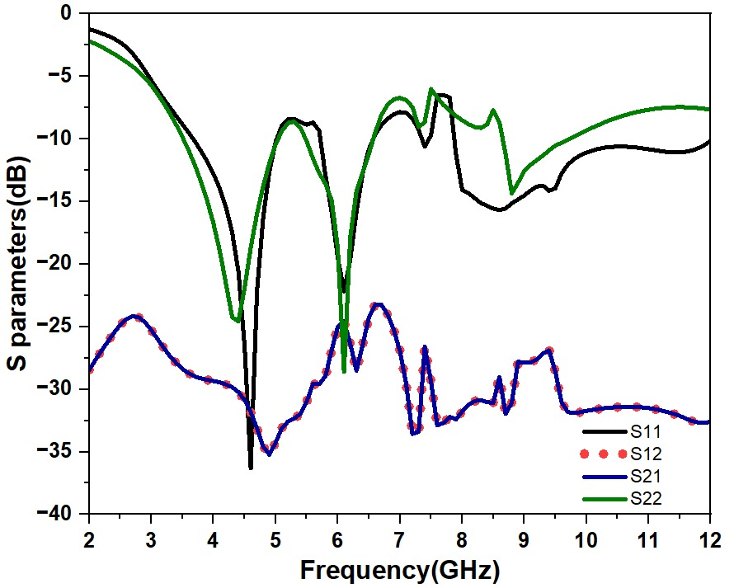
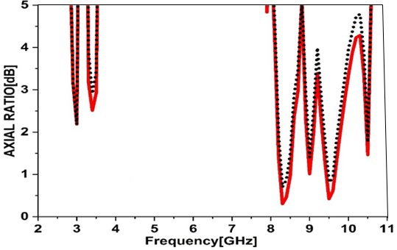
Results
S-Parameter of MIMO antenna
Axial ratio of port1 and port 2
Normally isolation below -15dB is considered as the good candidature for wireless applications but with the use of metamaterial loaded SRR the working band gets almost less than -20dB.
The antenna achieves good circular polarization (low axial ratio, ideally below 3 dB) around the 1 GHz frequency

Slide 12
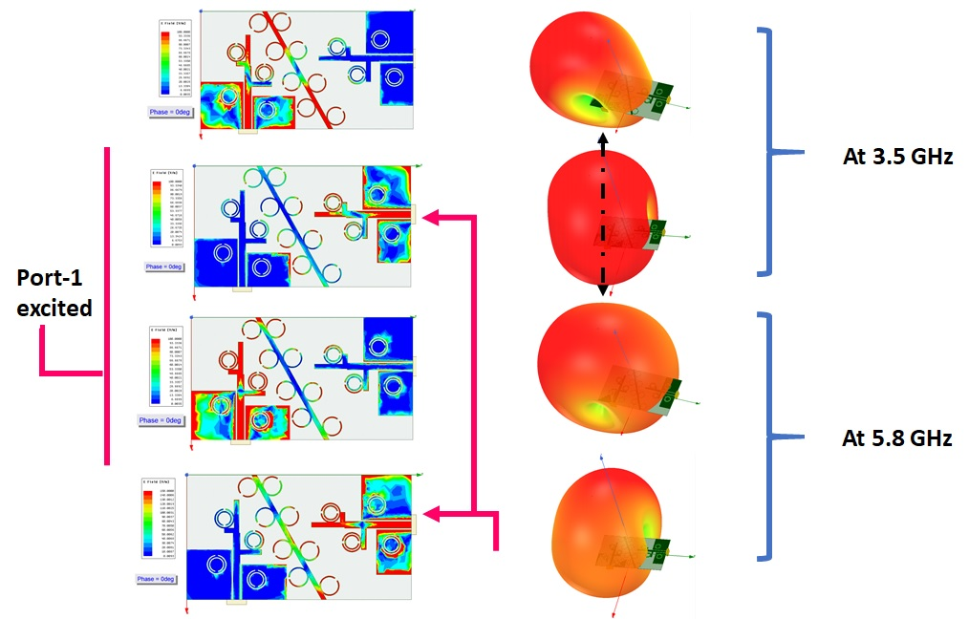
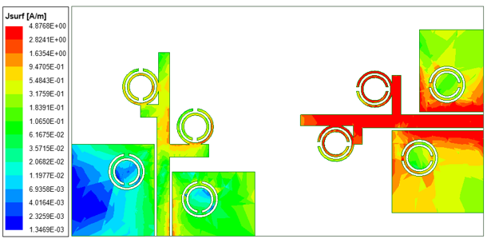
Results
At 3.5 GHz, the energy radiates in one direction, while at 5.8 GHz, it radiates in a different direction. This means the antenna changes its behavior with frequency, which helps improve signal diversity and performance in MIMO systems
Current orientation Plot Showing Mutual Coupling in the Absence of Isolation Stub
Current orientation and pattern orientation of the conformal antenna hen port 1 and 2 excited at 3.5GHz and 5.8GHz Frequencies

Slide 13
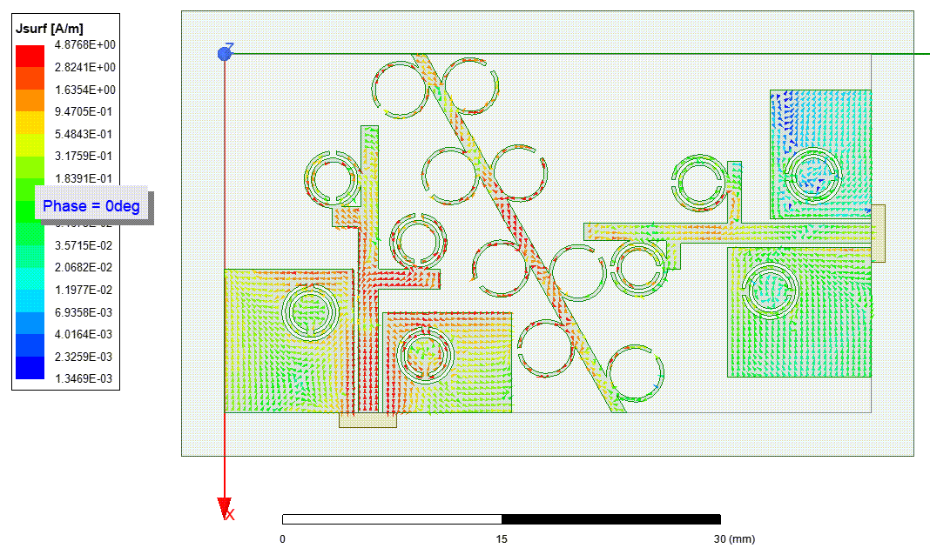
Results
Circular polarization (CP) is achieved using a combination of antenna placement, Asymmetric ground plane, and Metamaterial elements
In the proposed antenna, the stub with SRRs, combined with offset geometry and asymmetric current distribution, causes the surface currents to rotate in a clockwise direction at all resonant frequencies, thereby generating right-hand circular polarization (RHCP).
The current distribution at Port 1 for the resonant frequency clearly demonstrates the generation of circular polarization (CP) in the antenna

Slide 14
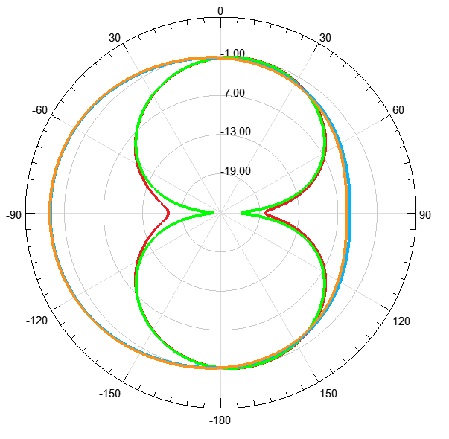
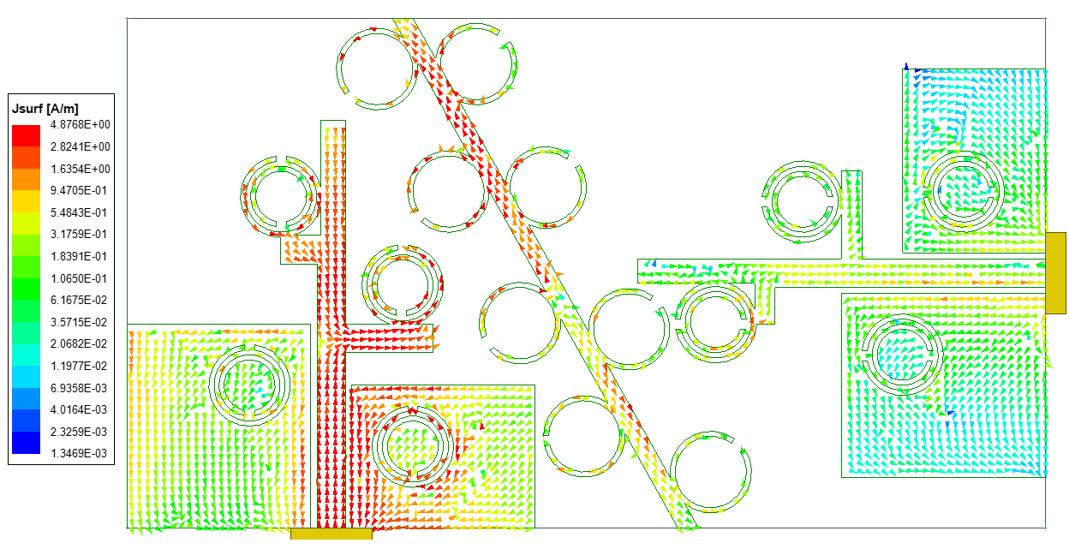
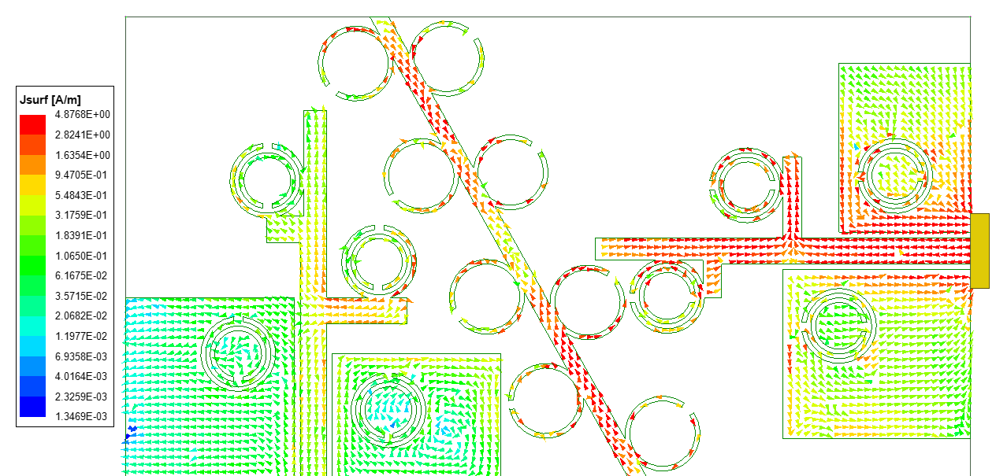
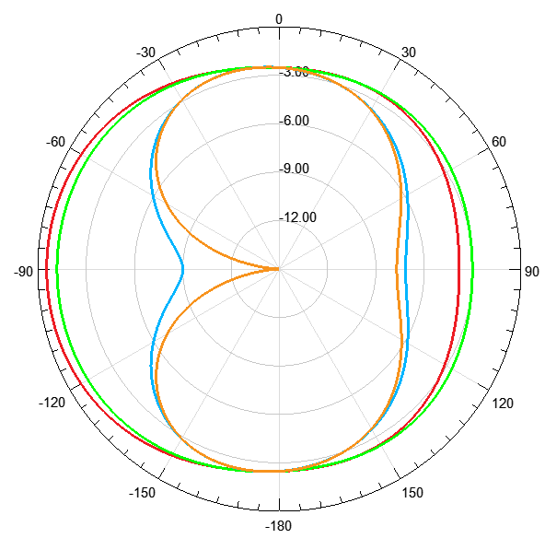
Results
Port 1 vs Port 2 Excitation at 5.8 GHz
Top Row: Port 1 active, Port 2 terminated
Bottom Row: Port 2 active, Port 1 terminated
Left: Current Distribution
Right: 2D Radiation Pattern
Surface Current Distribution and Radiation Patterns at 5.8 GHz for Port 1 and Port 2 Excitation

Slide 15
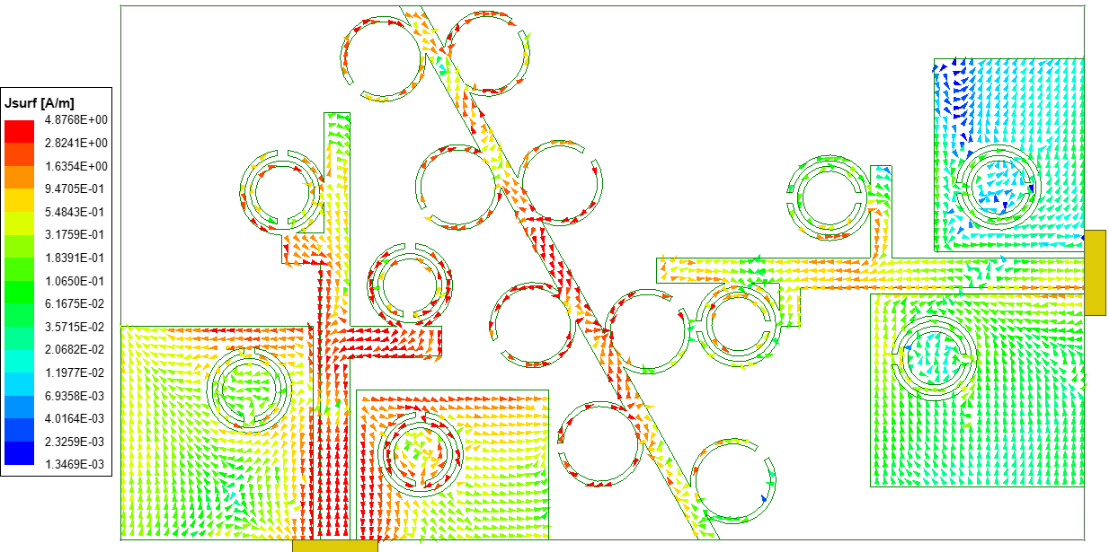
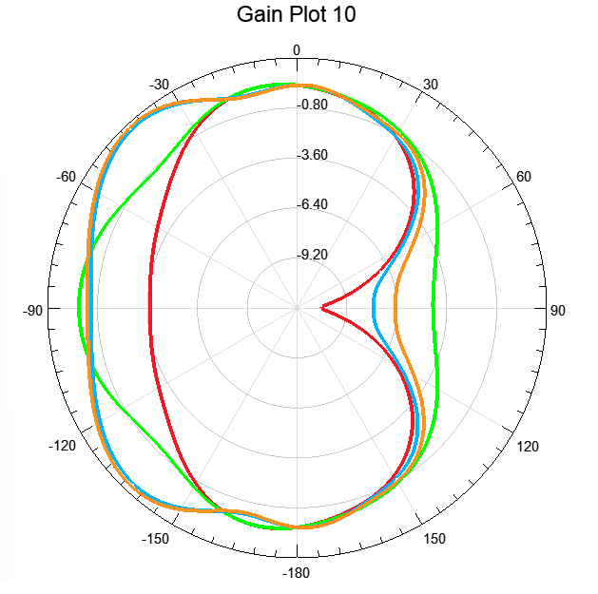
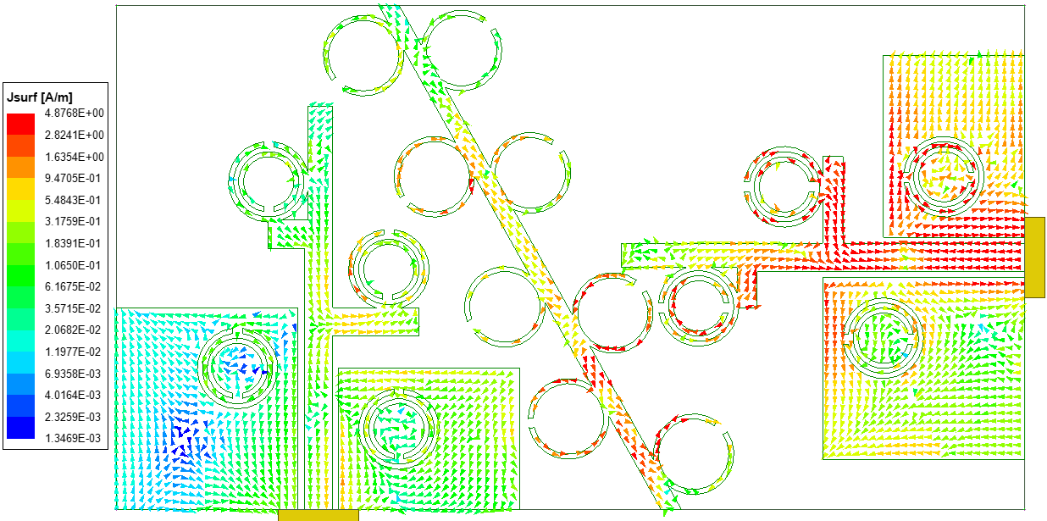
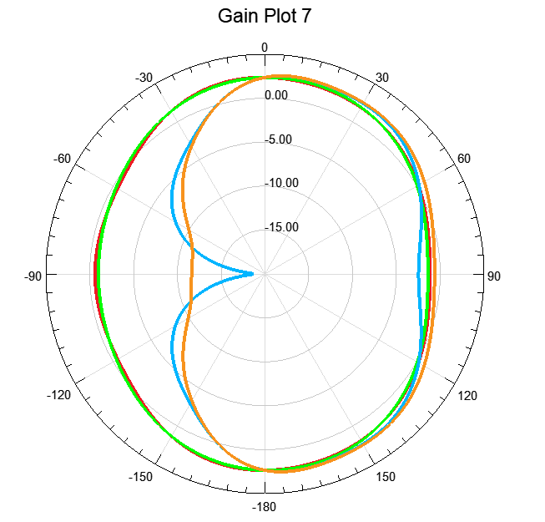
Results
Port 1 vs Port 2 Excitation at 10.56 GHz
Top Row: Port 1 active, Port 2 terminated
Bottom Row: Port 2 active, Port 1 terminated
Left: Current Distribution
Right: 2D Radiation Pattern
Surface Current Distribution and Radiation Patterns at 10.56 GHz for Port 1 and Port 2 Excitation

Slide 16
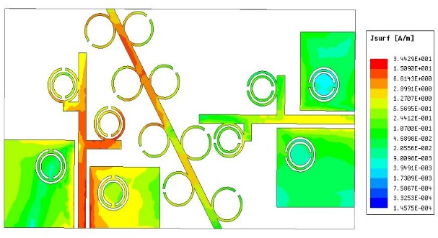
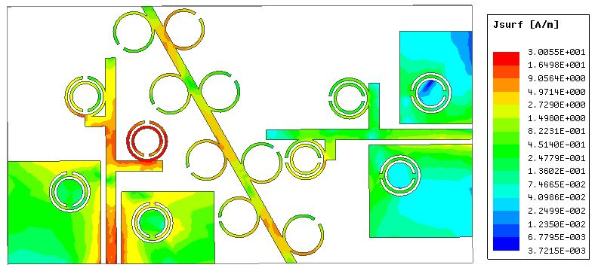
Results
Current vectors at (a)4.1GHz (b) at 5.8GHz for Port 1 Excitation
When Port 1 is active, the stub and nearby SRRs capture part of the surface current and redirect it with a phase shift, altering the electric field direction. Importantly, there is no direct current flow to Port 2, so isolation is maintained while enabling polarization diversity.

Slide 17
Conclusions
This paper presents a Wide Band MIMO antenna inspired by metamaterial split ring resonators. Simulation results show that the antenna performs well for real-time wireless communication.
It offers good isolation below –15 dB, a simple structure, and is easy to fabricate. In future work.
The design will be further developed to achieve a flexible antenna structure for UWB application

Slide 18
References
Kumar, J. P., and G. Karunakar. "Ultra wideband MIMO notched antenna for WLAN and mobile applications." International Journal of Pure and Applied Mathematics 118.9 (2018): 929-934.
Kumar, J. Prasanth, and G. Karunakar. "Circular slotted ring shaped mimo antenna for ultra wideband applications." 2018 IEEE International Conference on Computational Intelligence and Computing Research (ICCIC). IEEE, 2018.
Rao, M. Venkateswara, et al. "Metamaterial inspired quad band circularly polarized antenna for WLAN/ISM/Bluetooth/WiMAX and satellite communication applications." AEU-International Journal of Electronics and Communications 97 (2018): 229-241.
Tiwari, Rakesh N., et al. "Compact circularly polarized MIMO printed antenna with novel ground structure for wideband applications." International Journal of RF and Microwave Computer‐Aided Engineering 31.8 (2021): e22737.
Chen, Hsiang Nerng, Jeong-Moon Song, and Jung-Dong Park. "A compact circularly polarized MIMO dielectric resonator antenna over electromagnetic band-gap surface for 5G applications." IEEE Access 7 (2019): 140889-140898.
Sahu, Nikesh Kumar, Gourab Das, and Ravi Kumar Gangwar. "L‐shaped dielectric resonator based circularly polarized multi‐input‐multi‐output (MIMO) antenna for wireless local area network (WLAN) applications." International Journal of RF and Microwave Computer‐Aided Engineering 28.9 (2018): e21426.
Khan, Ijaz, et al. "Designed circularly polarized two-port microstrip MIMO antenna for WLAN applications." Applied sciences 12.3 (2022): 1068.

Slide 19
THANK YOU

